Slide 1
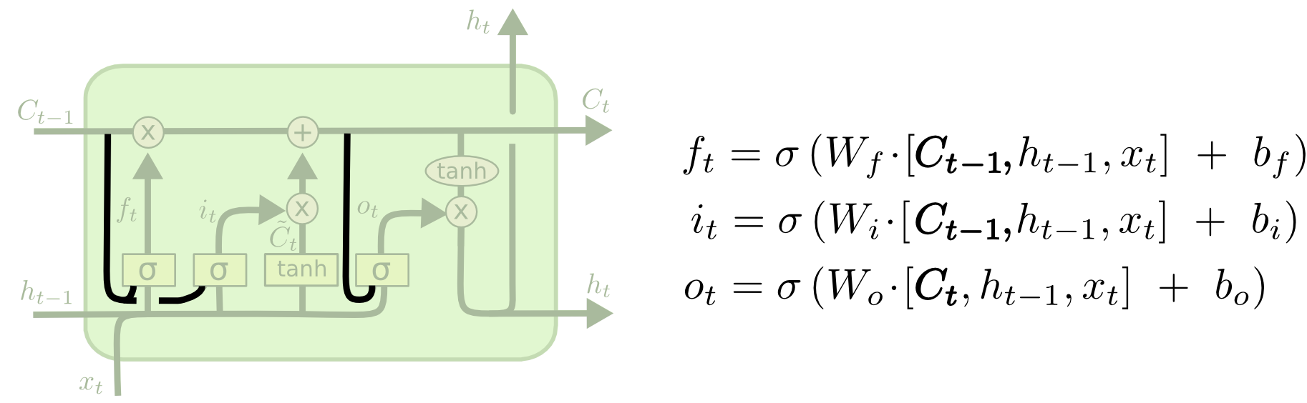

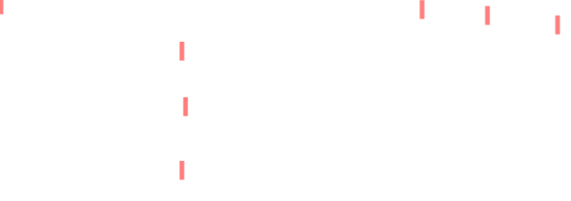
Extended Versions
1. One popular LSTM variant, introduced by Gers & Schmidhuber (2000), is adding “peephole connections.” This means that we let the gate layers look at the cell state.

Slide 2
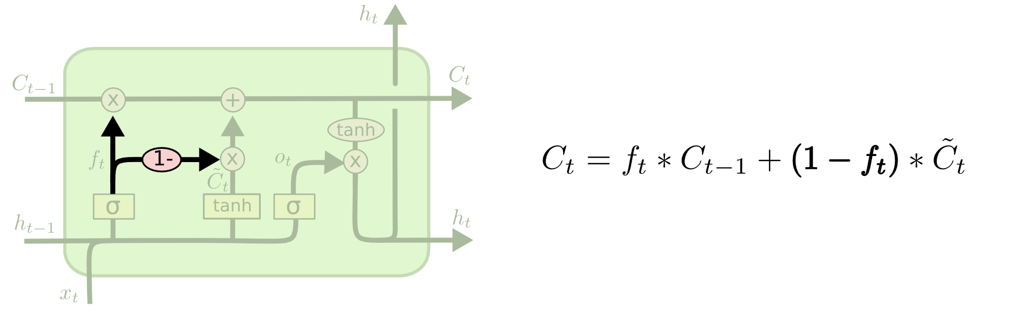

2. Another variation is to use coupled forget and input gates. Instead of separately deciding what to forget and what we should add new information to, we make those decisions together. We only forget when we’re going to input something in its place. We only input new values to the state when we forget something older.

Slide 3
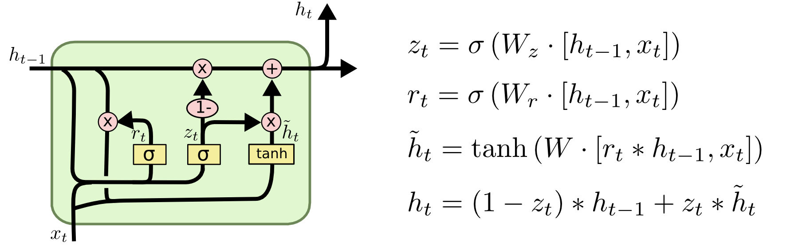
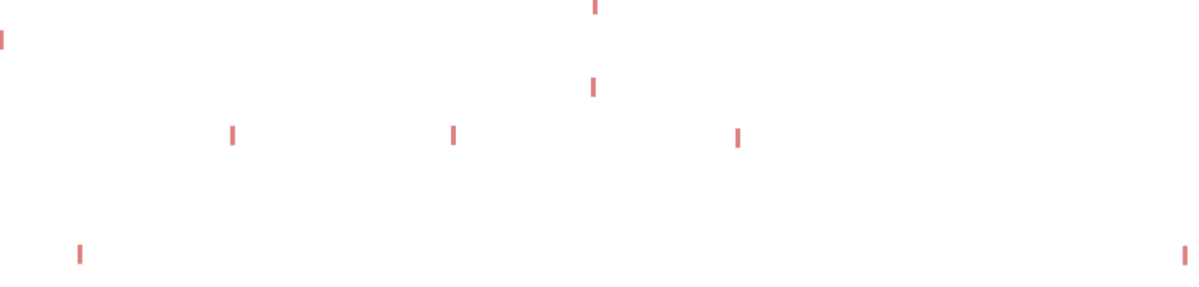
3. A slightly more dramatic variation on the LSTM is the Gated Recurrent Unit, or GRU, introduced by Cho, et al. (2014). It combines the forget and input gates into a single “update gate.” It also merges the cell state and hidden state, and makes some other changes. The resulting model is simpler than standard LSTM models, and has been growing increasingly popular.

Slide 4
Thank you
End of Chapter 3

